Slide 1
Detecting undetectables: Can conductances of action potential models be changed without appreciable change in the transmembrane potential?
Journal club
Will An

Slide 2



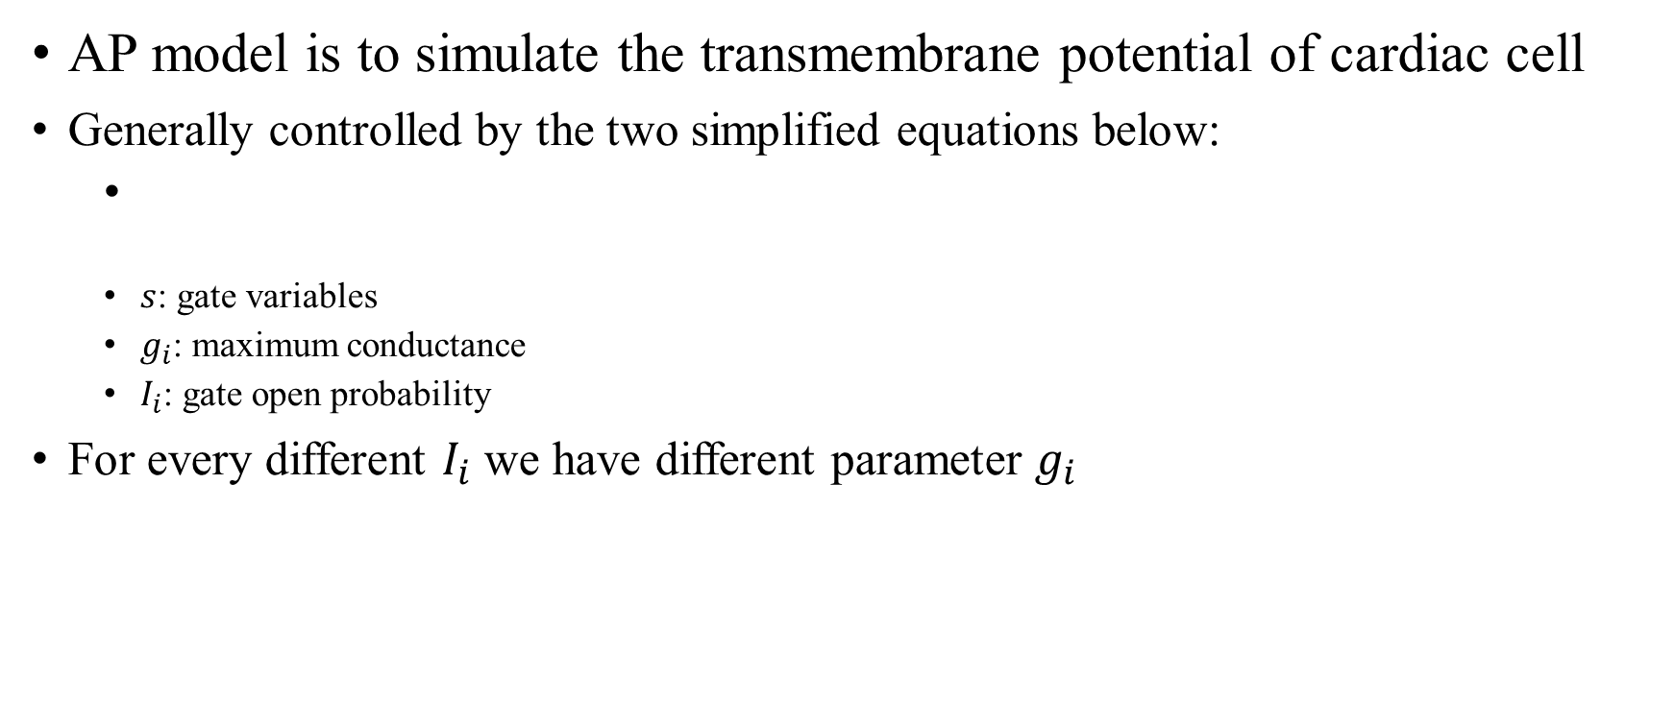
Introduction – Action Potential (AP) model
AP model is to simulate the transmembrane potential of cardiac cell
Generally controlled by the two simplified equations below:
$s$: gate variables
$g_{i}$: maximum conductance
$I_{i}$: gate open probability
For every different $I_{i}$ we have different parameter $g_{i}$

Slide 3
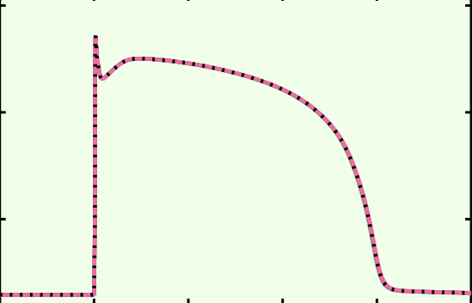



Introduction – Action Potential (AP) model
Some parameters are insensitive: if we slightly change them, the sum of currents or AP does not change much.
For example, if we perturb conductance of background Na.
${g_{bNa}→\left(1+ε\right)g}_{bNa}$
Perturbed $g_{bNa}$
Default $g_{bNa}$

Slide 4
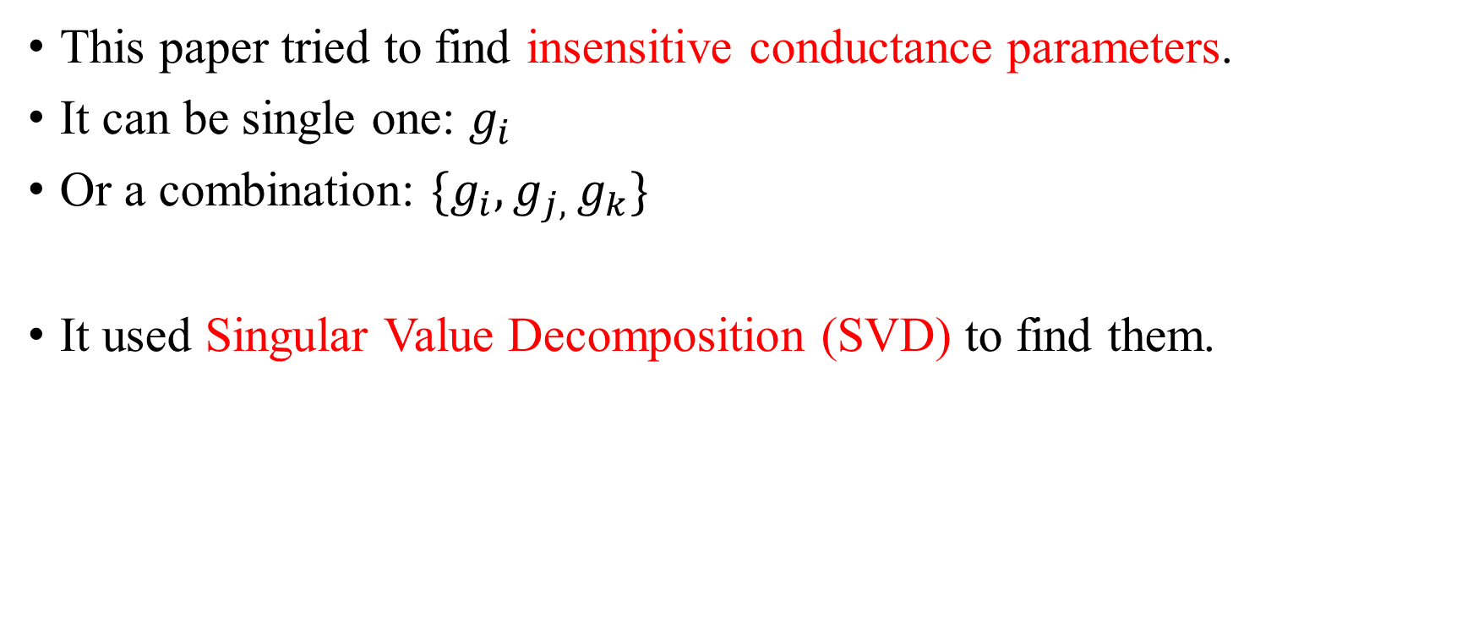
Introduction – Action Potential (AP) model
This paper tried to find insensitive conductance parameters.
It can be single one: $g_{i}$
Or a combination: ${\{g}_{i},g_{j, }g_{k}\}$
It used Singular Value Decomposition (SVD) to find them.

Slide 5
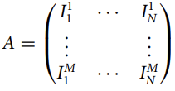
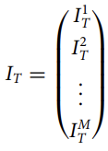
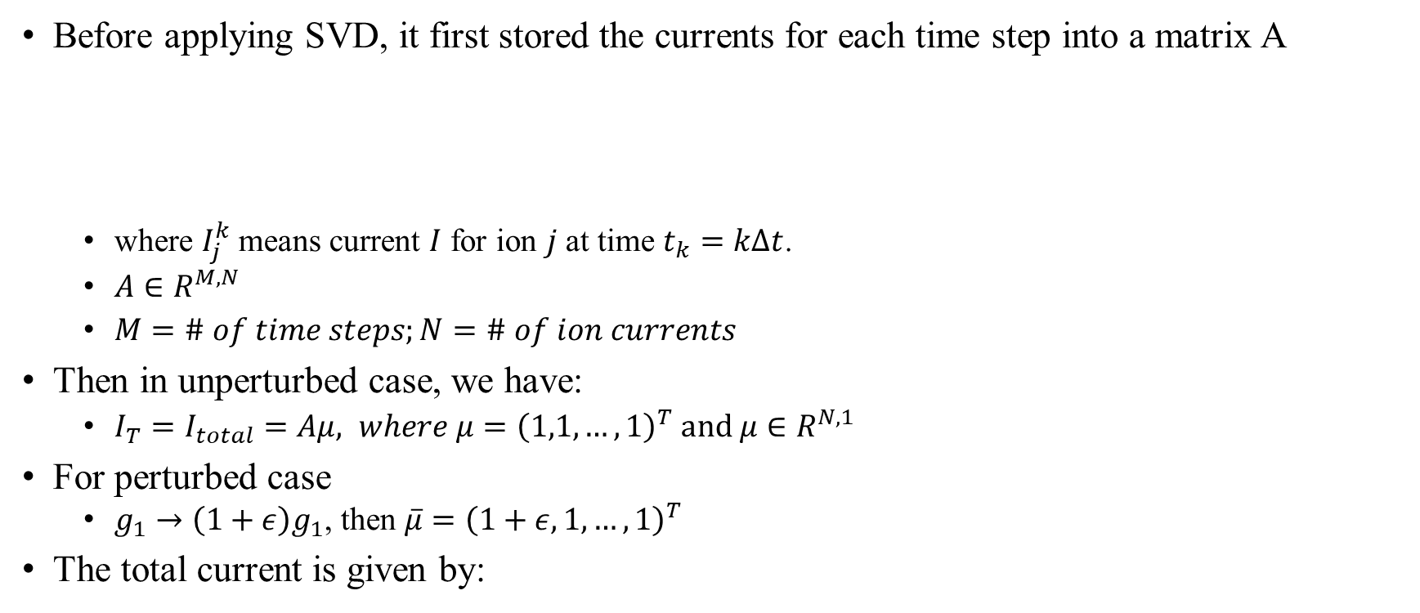
Method – Matrix representation
Before applying SVD, it first stored the currents for each time step into a matrix A
where $I_{j}^{k}$ means current $I$ for ion $j$ at time $t_{k}=kΔt$.
$A∈R^{M,N}$
$M=\# of time steps;N=\# of ion currents$
Then in unperturbed case, we have:
${I_{T}=I}_{total}=Aμ, where μ={\left(1,1,…,1\right)}^{T} and μ∈R^{N,1}$
For perturbed case
${g_{1}→\left(1+ε\right)g}_{1}$, then $\overline{μ}={\left(1+ε,1,…,1\right)}^{T}$
The total current is given by:

Slide 6
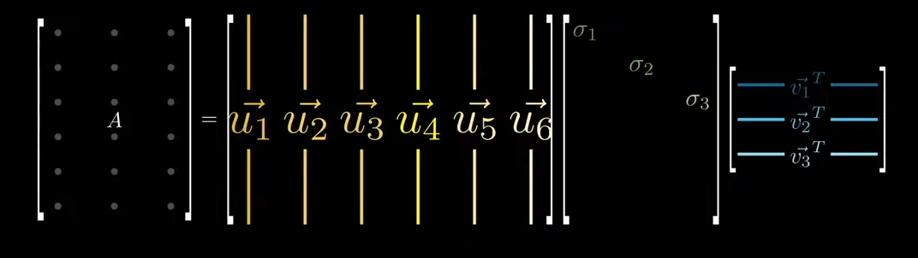





Method – SVD
Singular Value Decomposition can decompose any matrix into three matrix.
$∀ A∈R^{M,N}, A=UΣV^{T}$
$\vec{u_{i}}$: left singular vectors
$σ_{i}$: singular values
$\vec{v_{i}}$: right singular vectors
Some properties of SVD
$σ_{i}=0 if i>r$
$A\vec{v_{i}}=σ_{i}\vec{u_{i}}, i=1,…,r$
$A\vec{v_{i}}=0, i=r+1,…,N$
Where r is the rank of matrix $A$
$\{{v_{1},v_{2},…,v}_{N}\}$ is an orthonormal basis.
$${A∈R}^{M,N}$$
$${U∈R}^{M,M}$$
$${Σ∈R}^{M,N}$$
$${V∈R}^{N,N}$$

Slide 7






Method – Perturbation effect on currents
Now consider a specific perturbation $\overline{μ}=μ+εv_{i}$
$I_{T}=Aμ, { \overline{I}}_{T}=A\overline{μ},A\vec{v_{i}}=σ_{i}\vec{u_{i}}$
where $\left(u_{i},u_{i}\right) is the inner product of u_{i}, and is one$
Finally: $\left|\left|I_{T}−{\overline{I}}_{T}\right|\right|=εσ_{i}$
Meaning if we have a small singular value $σ_{i}$, that perturbing direction is insensitive.
$${A∈R}^{M,N}$$
$${U∈R}^{M,M}$$
$${Σ∈R}^{M,N}$$
$${V∈R}^{N,N}$$

Slide 8

Method – Perturbation effect on currents
Finally: $\left|\left|I_{T}−{\overline{I}}_{T}\right|\right|=εσ_{i}$
But this perturbation only lies on certain direction $v_{i}$
For example, if $v_{i}={\left(\frac{1}{\sqrt{2 }},\frac{1}{\sqrt{2}},0,0,…,0\right)}^{T}$, we only perturbed $g_{1}, g_{2} by \frac{ε}{\sqrt{2}}$
So, what if we want to discuss all possible perturbations of $\left\{g_{i}\right\}$?

Slide 9
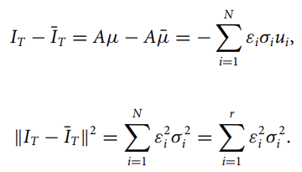
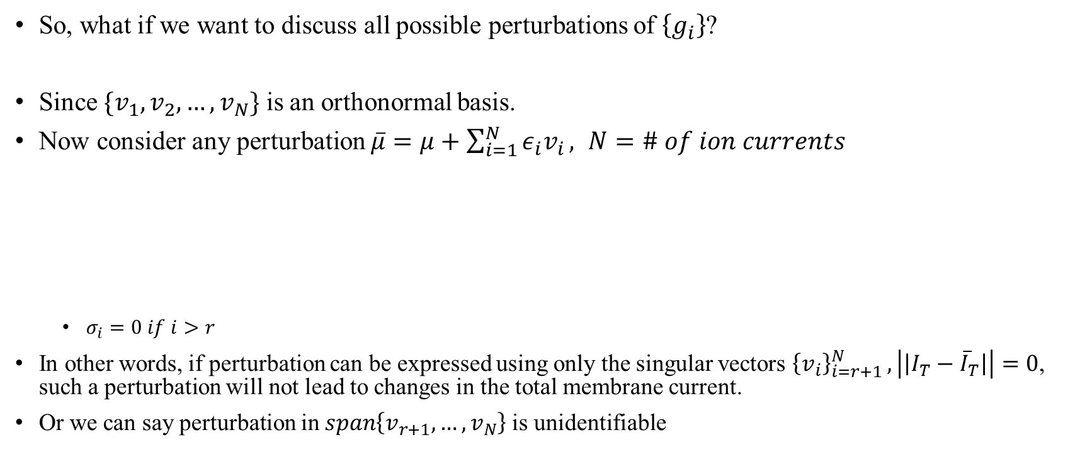
Method – Perturbation effect on currents
So, what if we want to discuss all possible perturbations of $\left\{g_{i}\right\}$?
Since $\{{v_{1},v_{2},…,v}_{N}\}$ is an orthonormal basis.
Now consider any perturbation $\overline{μ}=μ+\sum_{i=1}^{N}{ε_{i}v_{i}}, N=\# of ion currents$
$σ_{i}=0 if i>r$
In other words, if perturbation can be expressed using only the singular vectors ${\left\{v_{i}\right\}}_{i=r+1 }^{N}, \left|\left|I_{T}−{\overline{I}}_{T}\right|\right|=0$, such a perturbation will not lead to changes in the total membrane current.
Or we can say perturbation in $span\left\{v_{r+1},…,v_{N}\right\}$is unidentifiable

Slide 10



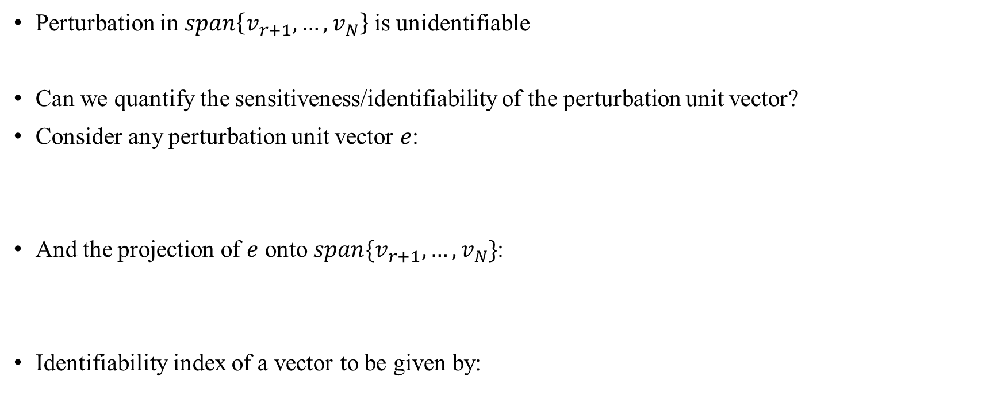
Method – Identifiability index (current)
Perturbation in $span\left\{v_{r+1},…,v_{N}\right\}$is unidentifiable
Can we quantify the sensitiveness/identifiability of the perturbation unit vector?
Consider any perturbation unit vector $e$:
And the projection of $e$ onto $span\{v_{r+1},…,v_{N}\}$:
Identifiability index of a vector to be given by:

Slide 11

Method – Identifiability index (current)
Perturbation in $N=span\left\{v_{r+1},…,v_{N}\right\}$is unidentifiable
Identifiability index of a vector to be given by:
If $k\left(e\right)=1:$
$P_{N}e=0,$ meaning part of the vector that cannot be identified = 0
Perturbation in direction e is identifiable
If $k\left(e\right)=0:$
$P_{N}e=1,$ meaning e is in $span\left\{v_{r+1},…,v_{N}\right\}$
Perturbation in direction e is unidentifiable

Slide 12

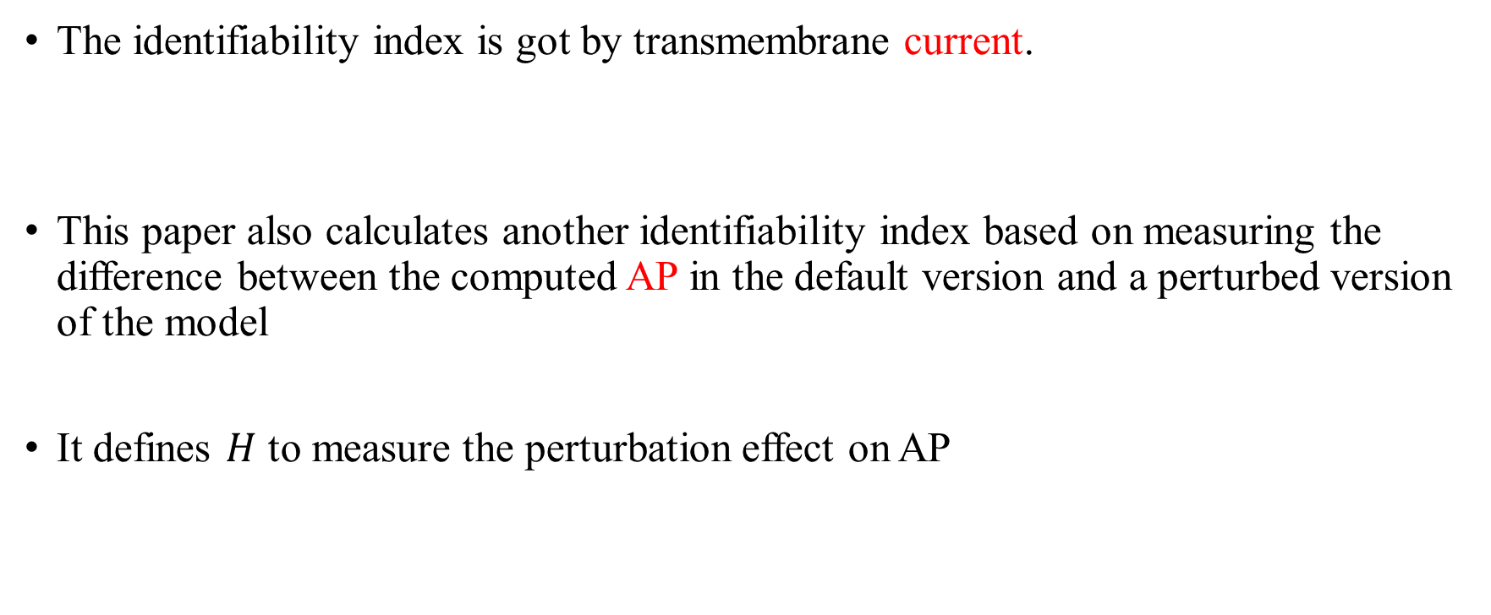
Method – Identifiability index (AP)
The identifiability index is got by transmembrane current.
This paper also calculates another identifiability index based on measuring the difference between the computed AP in the default version and a perturbed version of the model
It defines $H$ to measure the perturbation effect on AP

Slide 13
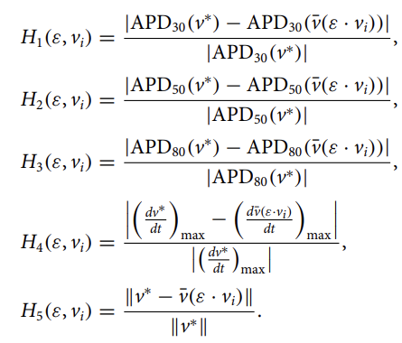


Method – Identifiability index (AP)
It defines $H$ to measure the perturbation effect on AP

Slide 14


Method – Identifiability index (AP)
It defines $H$ to measure the perturbation effect on AP
Perturbation in $S$is unidentifiable ($δ=0.25$, is the threshold value)
If $k\left(e\right)=1:$
$P_{N}e=0,$ meaning part of the vector that cannot be identified = 0
Perturbation in direction e is identifiable
If $k\left(e\right)=0:$
$P_{N}e=1,$ meaning e is in $span\left\{v_{r+1},…,v_{N}\right\}$
Perturbation in direction e is unidentifiable

Slide 15
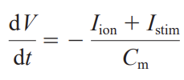
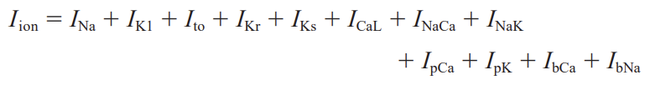

Result - Tusscher model
Tusscher model:
It perturbed the model by singular vectors
Record currents every $Δt=0.1ms$

Slide 16
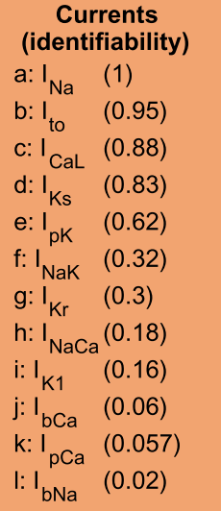
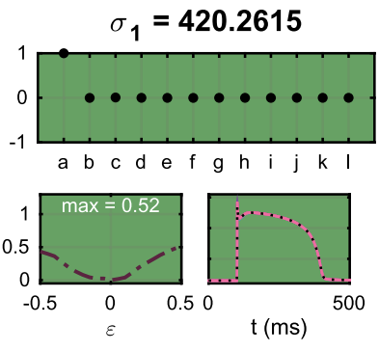
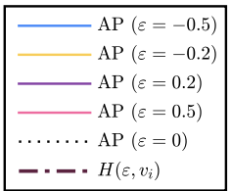
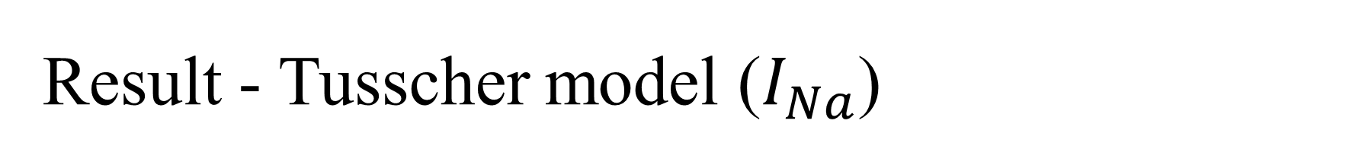

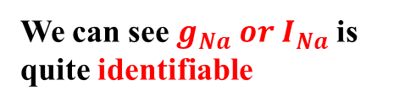
Result - Tusscher model ($I_{Na}$)
Perturbation by $v_{1}={\left(1,0,…,0\right)}^{T}$
Meaning $I_{Na}$ is multiplied by a factor $1+1ε$
Or we can say $g_{Na}→\left(1+ε\right)g_{Na}$
Singular vector or
Perturb vector
We can see $g_{Na} or I_{Na}$ is quite identifiable
Perturb effect H

Slide 17
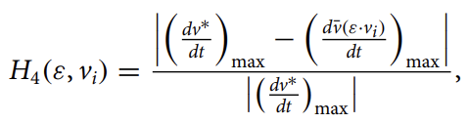
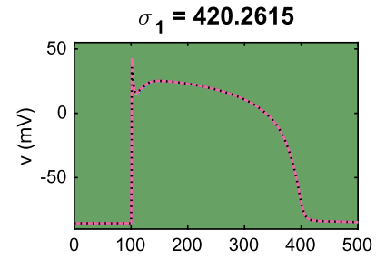
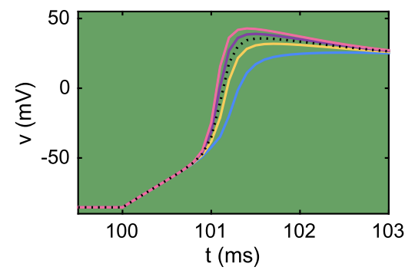

Result - Tusscher model ($I_{Na}$)
You may wonder why for $I_{Na}$ has a large H but almost same AP for different perturbation $ε$
That is because fast sodium current $I_{Na}$ actives mainly during upstroke of AP
Where $H$ mainly comes from $H_{4}$
It measures the maximal upstroke velocity

Slide 18
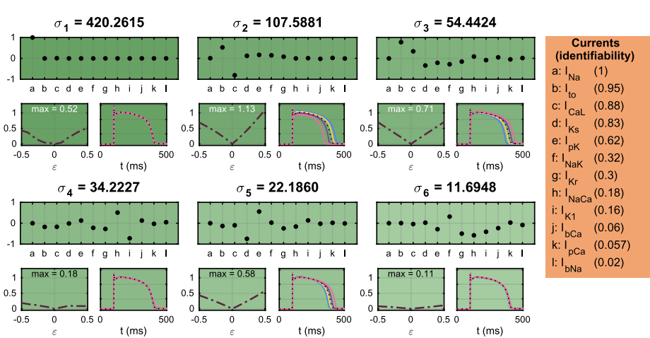
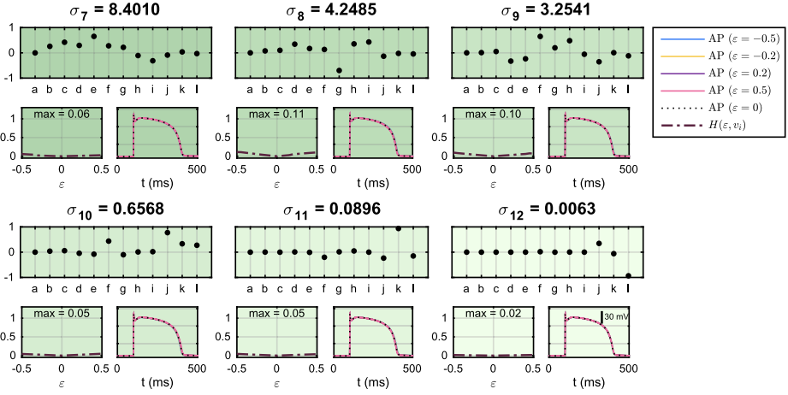
Result - Tusscher model

Slide 19
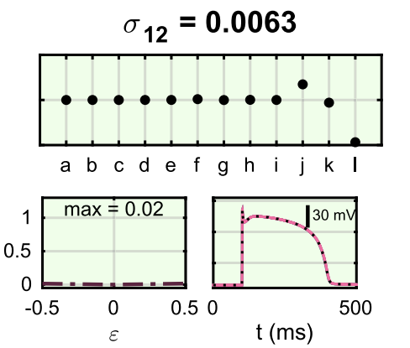
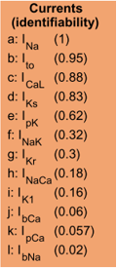
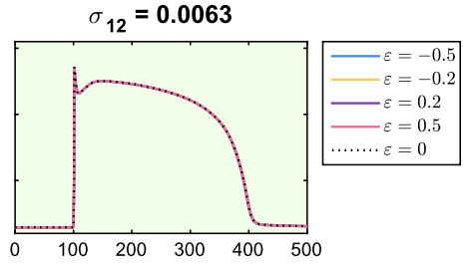
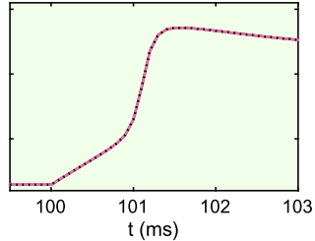
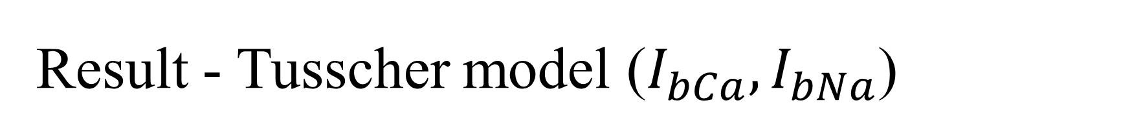

Result - Tusscher model ($I_{bCa}, I_{bNa}$)
For increasing $g_{bCa}$ decreasing $g_{bNa}$ combination,
the perturbation is quite unidentifiable.

Slide 20
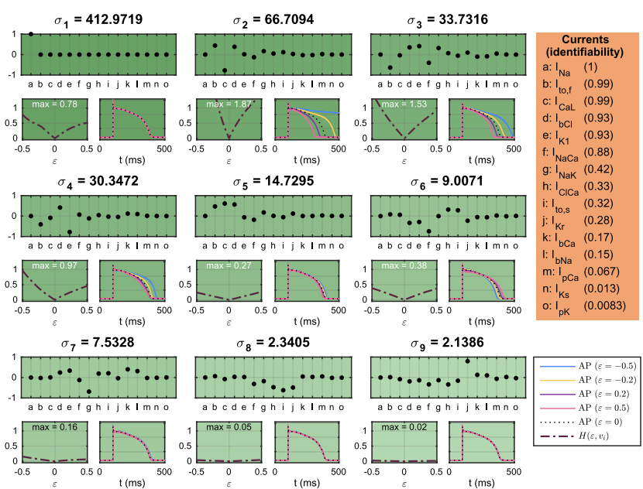
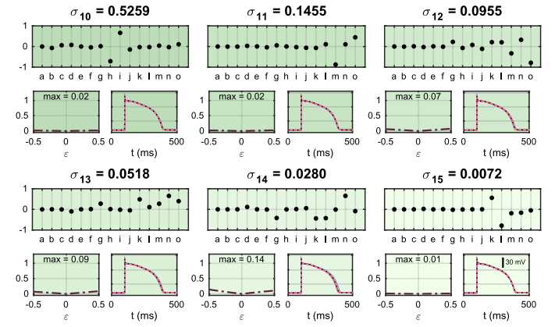
Result - Grandi model

Slide 21
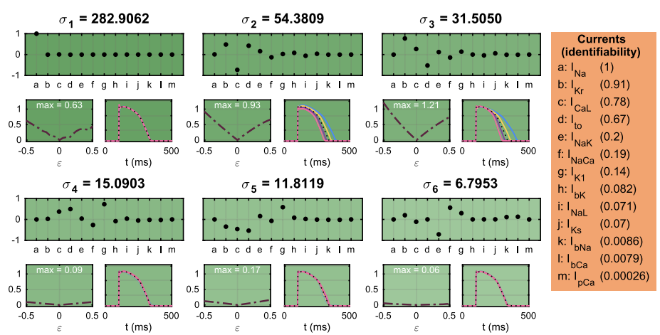
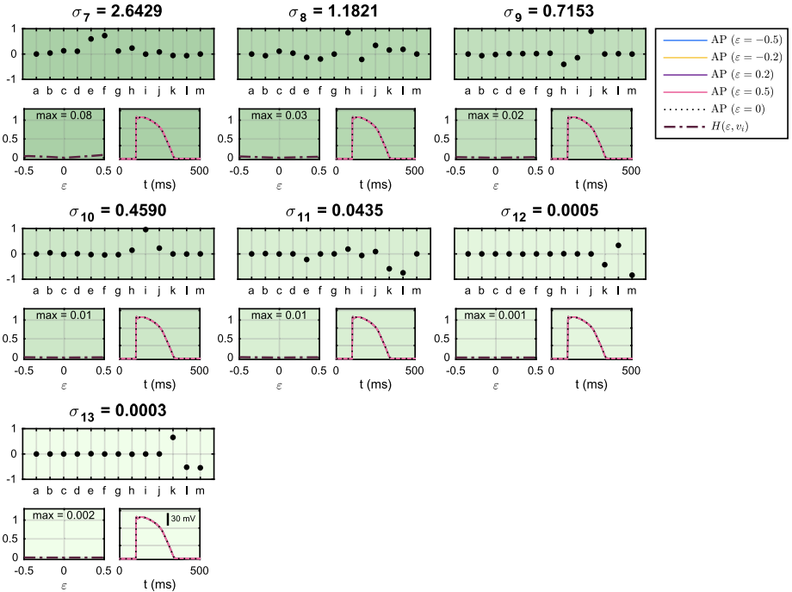
Result - O’Hara model

Slide 22
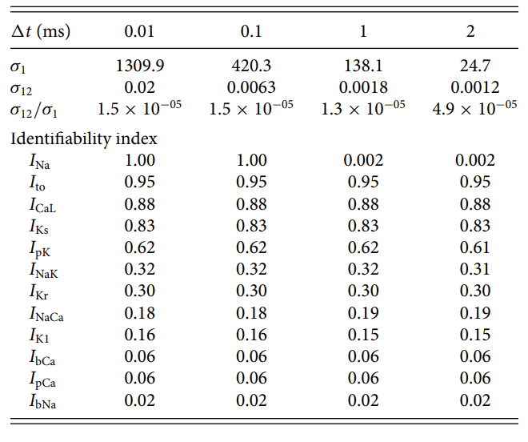
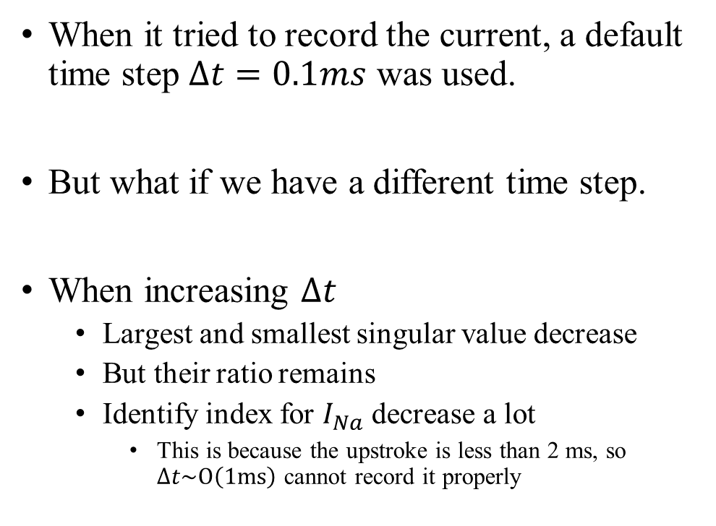
Result - Time step effect (Tusscher)
When it tried to record the current, a default time step $Δt=0.1ms$ was used.
But what if we have a different time step.
When increasing $Δt$
Largest and smallest singular value decrease
But their ratio remains
Identify index for $I_{Na}$ decrease a lot
This is because the upstroke is less than 2 ms, so $Δt\sim O\left(1ms\right)$ cannot record it properly

Slide 23
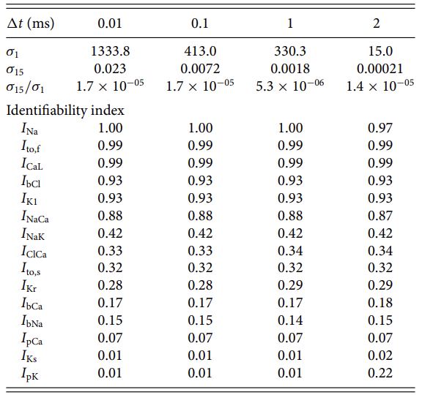
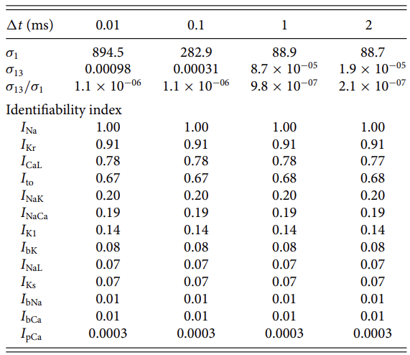
Result - Time step effect (Grandi and O’Hara)
Grandi
O’Hara

Slide 24
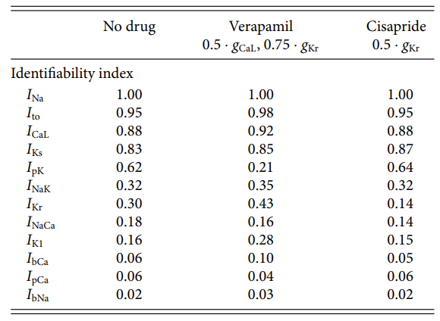
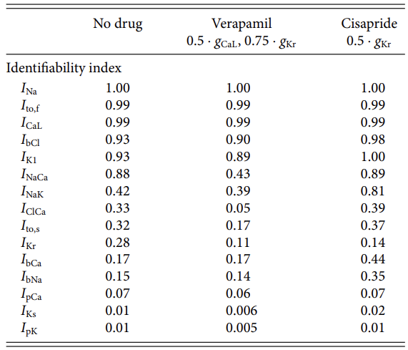

Result – Drug effect
Tusscher
Grandi
O’Hara

Slide 25


Result – Random stimulation protocol
Random stimulation protocol is applied to increase the identifiability index.
Instead of recording one stimulus of AP, here it records several additional stimulus (35.7 ms, 634.9 ms, 1392.5 ms, 2108.8 ms, 2426.9 ms, 2734.4 ms, 3161.8 ms, 3398.7 ms, 4073.6 ms and 4529.0 ms).

Slide 26



Result - Random stimulation (Tusscher)
We can see that the perturbation effect H and identify index are increased
Random stimulation
For reason of space, this paper does not show all singular values here

Slide 27




Result - Random stimulation (Grandi)
We can see that the perturbation effect H and identify index are increased
Random stimulation

Slide 28




Result - Random stimulation (O’Hara)
We can see that the perturbation effect H and identify index are increased
Random stimulation

Slide 29

Conclusion
It has developed a method for investigating the identifiability of the maximum conductance of ion channels in a model.
Large singular values are associated with large perturbation effects along their corresponding singular vectors, while small singular values are associated with small perturbation effects.
H is defined to measure perturbation effects on potential, which is especially useful when AP seemed to be visually identical.
The identifiability index is made to measure the difference between the unit vector of the current and the projection of the unit vector to the unidentifiable space.
Effect of time step: for the ten Tusscher model, the identifiability index of the $I_{Na}$ current dropped
Effect of drugs: few current identifiability index in Grandi and O’Hara model are affected.
Effect of stimulation: random stimulation protocol can increase identifiability index

Slide 30
Conclusion
This method is useful in the sense that it indicates how well blocking of individual currents can be identified using the model.
For instance, that the AP model is very sensitive to changes in the sodium current. Then, if a sodium blocker is applied, such changes will be observed.
But not all currents are identifiable, which indicates redundancy in the model in their ability to produce a single paced action potential (but not for random stimulus protocol).
So, we might need model reduction to make it simpler in the future work.

